Slide 1
2023

Slide 2
Mission and values
In close cooperation with our partners we create reliable and available solutions for electric energy transmission, distribution and conversion, providing comfortable and safe environment for people’s lives and activities.

Slide 3
About us
Established
in
1999
7,5%
annually
Annual sales growth
Employees
More than
3000
20,5
thousand
Product range
88
thousand,
m²
72
thousand, m²
Production facilities
Warehouses’ area
Products manufactured at Russian factories, per year
218
mln
More than
50%
Of profit margin we
Invest to development
IEK GROUP is an international electrical engineering company, manufacturer and supplier of IEK and tekfor® electrical equipment, lighting equipment of IEK Lighting®, LEDEL® and FEREKS®, telecommunication products of ITK® and industrial automation equipment of ONI®, solar power systems NEOSUN®.
In 2020, MPS Soft, the developer of MasterSCADA® software, joined the IEK GROUP.

Slide 4
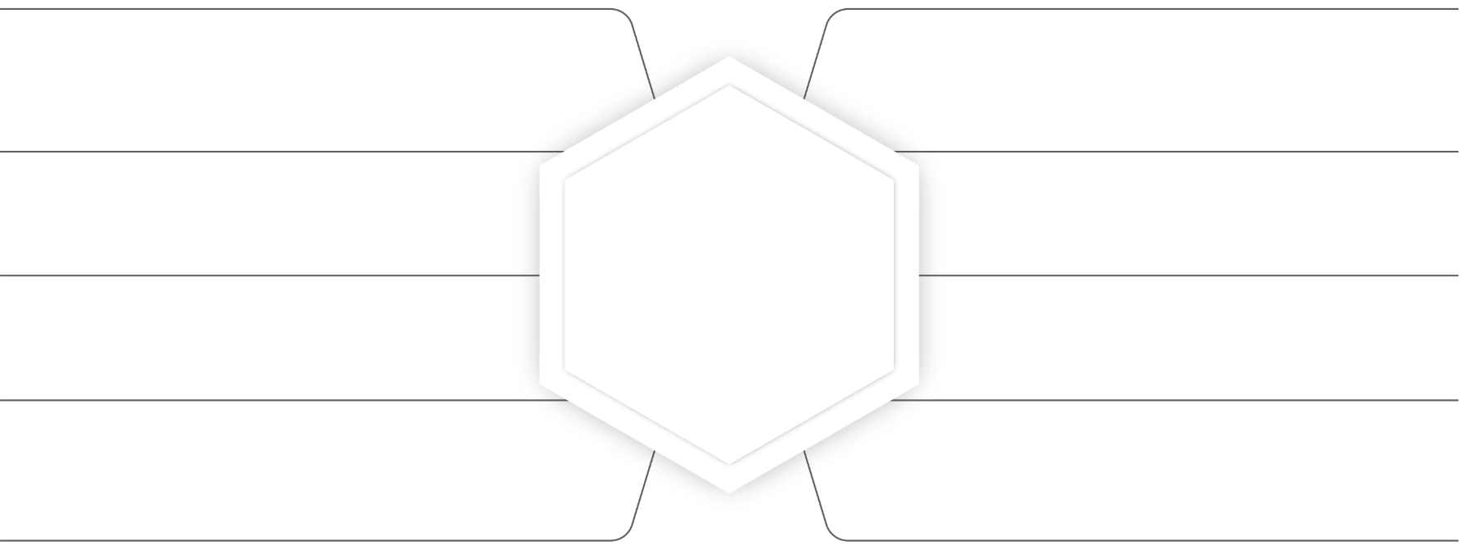
Our Brands
IEK® is the leader of electrotechnical and lighting markets for over 20 years.
№1 Electrotechnical Brand in Russia in 2014, 2016, 2019, 2021.
ITK® is a modern and reliable equipment for effective telecommunication solutions.
IEK Lighting® – a wide range of light sources, lamps, lighting control systems.
tekfor ® — Russian production of high-quality enclosures and accessories.
ONI® has a wide range of equipment and software automation of various industries.
LEDEL® is a professional lighting manufacturer of the project lighting for industrial, commercial, outdoor and office luminaries.
FEREKS® is a professional lighting manufacturer of the project lighting for industrial, commercial, outdoor and office luminaries.
MasterSCADA® — software solutions for the development of control and dispatching systems.
NeoSun Energy® — solutions for solar energy and energy storage.
Generica® — typical energy supply solutions in residential construction.

Slide 5
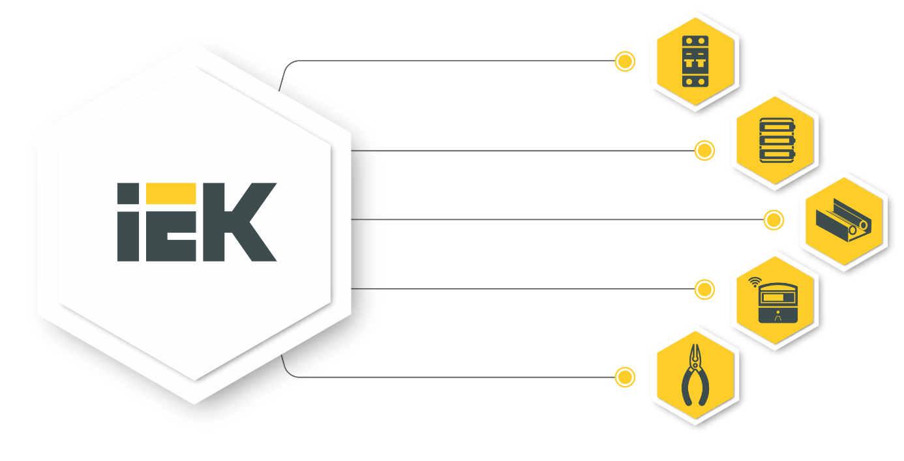
Electrotechnical equipment
Electric energy distribution equipment
Cabinets, boxes and accessories
Cable-carrying systems
Measuring and control equipment
Electrical wiring products, tools
www.iek.global

Slide 6
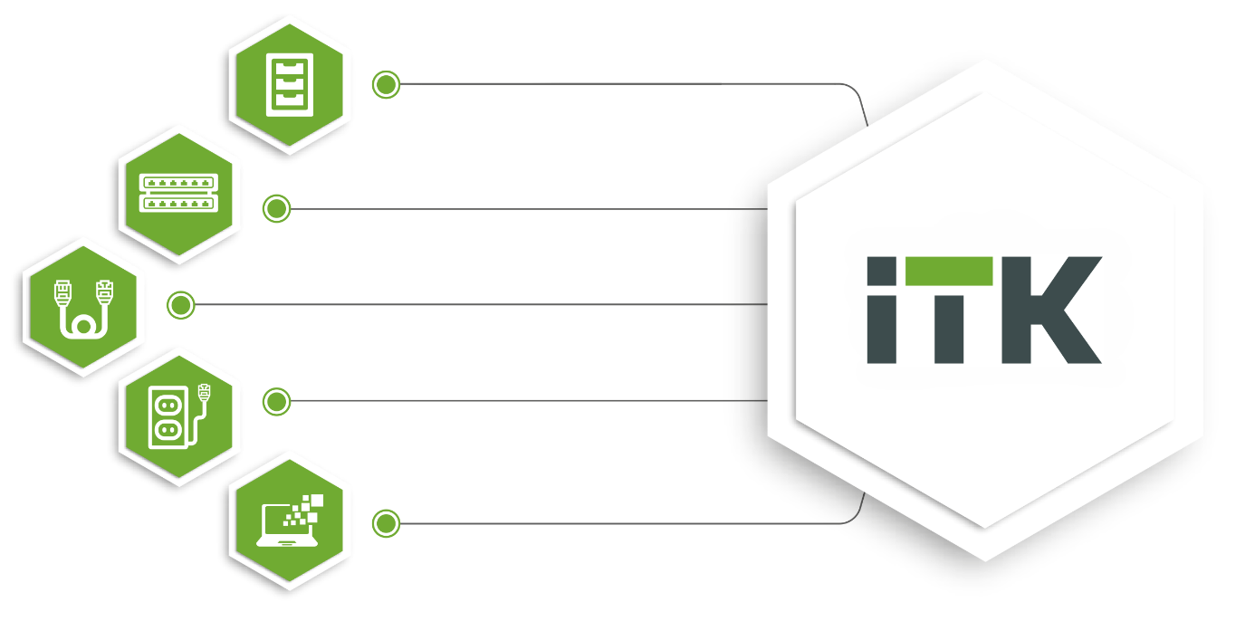
IT equipment
Wiring cabinets
Power supply equipment
LAN-cable
Copper and optical components for structured cabling systems
Software databases of equipment for projecting programs
High quality
Made in Russia
www.itk.group

Slide 7
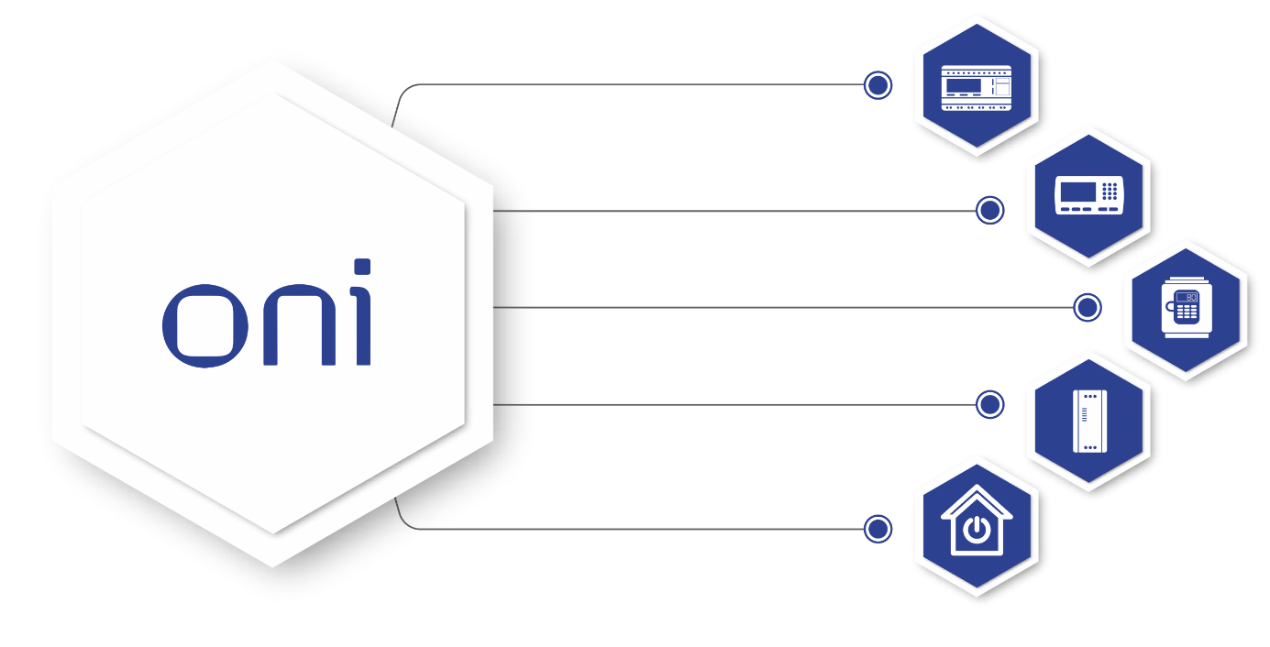
Industrial automation equipment
Programmed controllers
Controllers’ panels
Frequency converters
Softstarters
Smart Home
Manufacturing in modern factories
Multi-stage quality control
www.oni-system.com

Slide 8
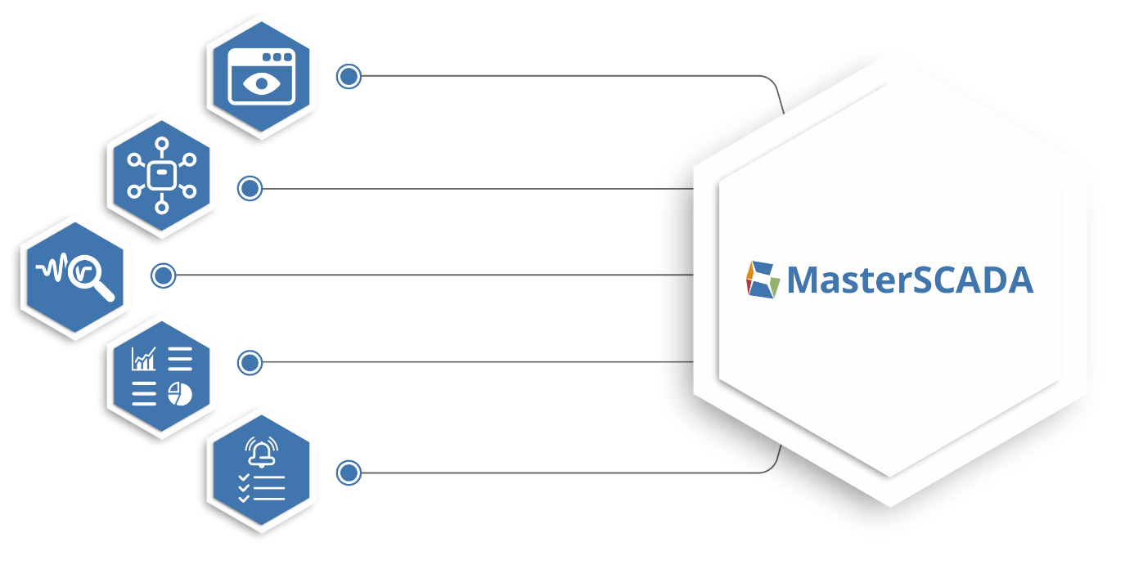
Platform for building and manufacturing automation
Process visualization
Extensive communication capabilities
Visual analytics
Powerful report editor
Managing events and alarms
Russian R&D
Industry 4.0 concept
www.masterscada.ru

Slide 9
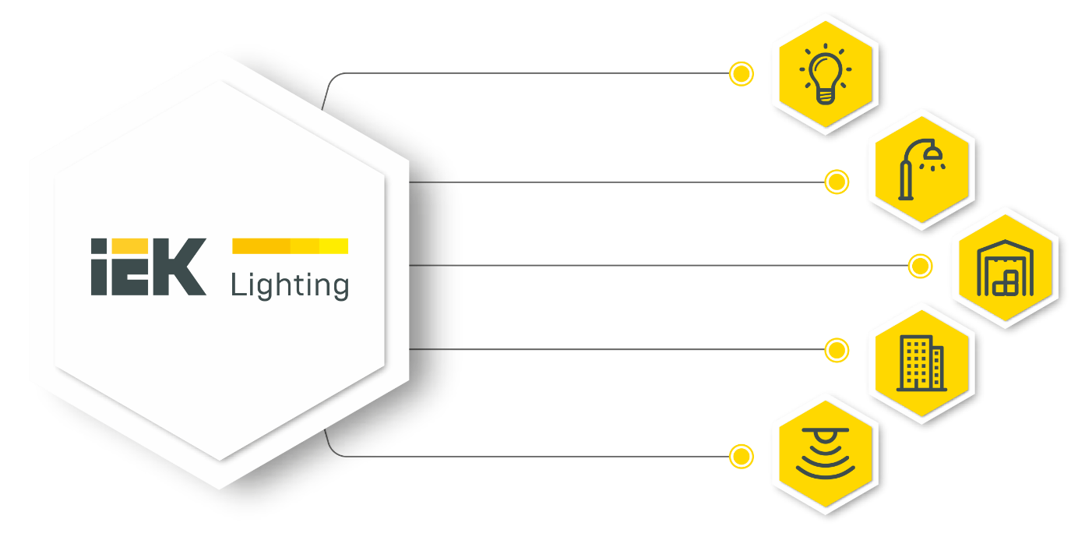
Lighting equipment
Bulbs
Street and architectural lighting
Commercial and industrial lighting
Utility and household lighting
Lighting control
Solutions for a variety of applications
Optimal price-quality ratio
www.iek.global

Slide 10
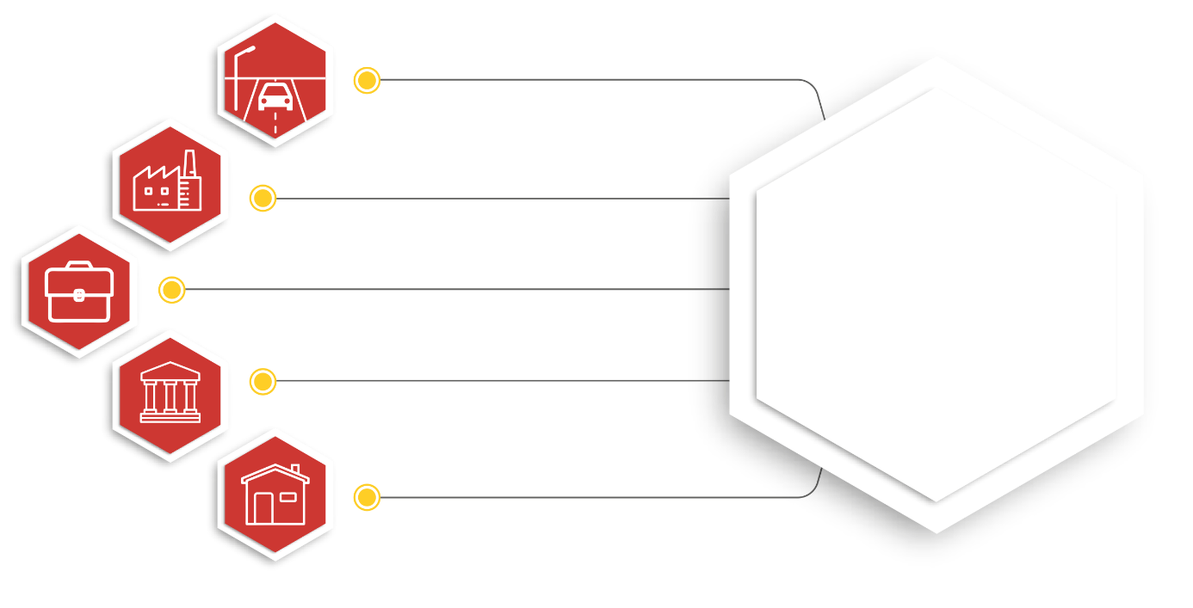
Professional technical lighting
Street and outdoor lighting
Industrial lighting
Commercial lighting
Architectural lighting
Office and household lighting
Design and production of innovative products in Russia
www.ledel.ru
www.fereks.ru

Slide 11
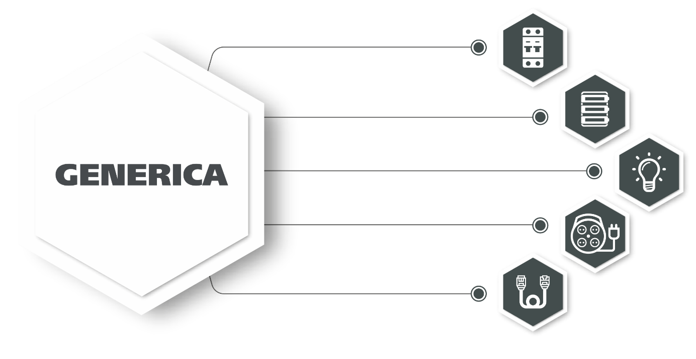
Typical energy supply solutions in residential construction
Protection and switching equipment
Cabinets, boxes and accessories
Lighting equipment
Electrical installation products
Telecommunication equipment
Optimal set of functions
Best price conditions
www.generica.su

Slide 12
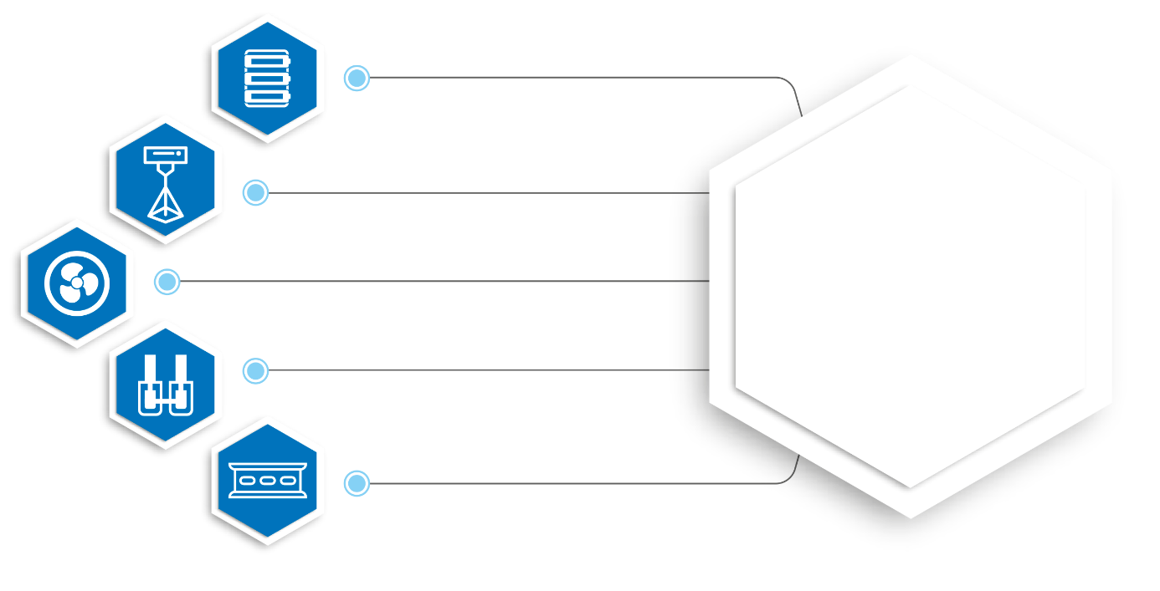
Enclosures and accessories
Plastic enclosures
Printing 2D and 3D images on products
Fan cases
Busbars and terminals
DIN-rails
Russian production of high-quality enclosures and accessories
www.tekfor.ru

Slide 13
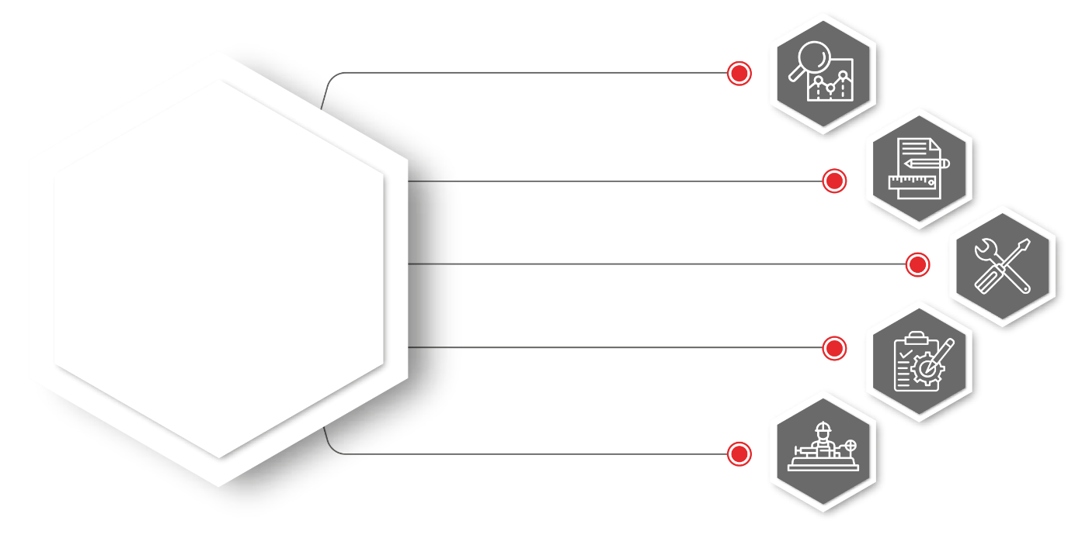
Solutions for solar energy and energy storage
Pre-project analysis
Design
Installation work
Commissioning works
Operation and maintenance
Optimum turnkey solutions
Engineering company with many years experience
www.neosun.com

Slide 14
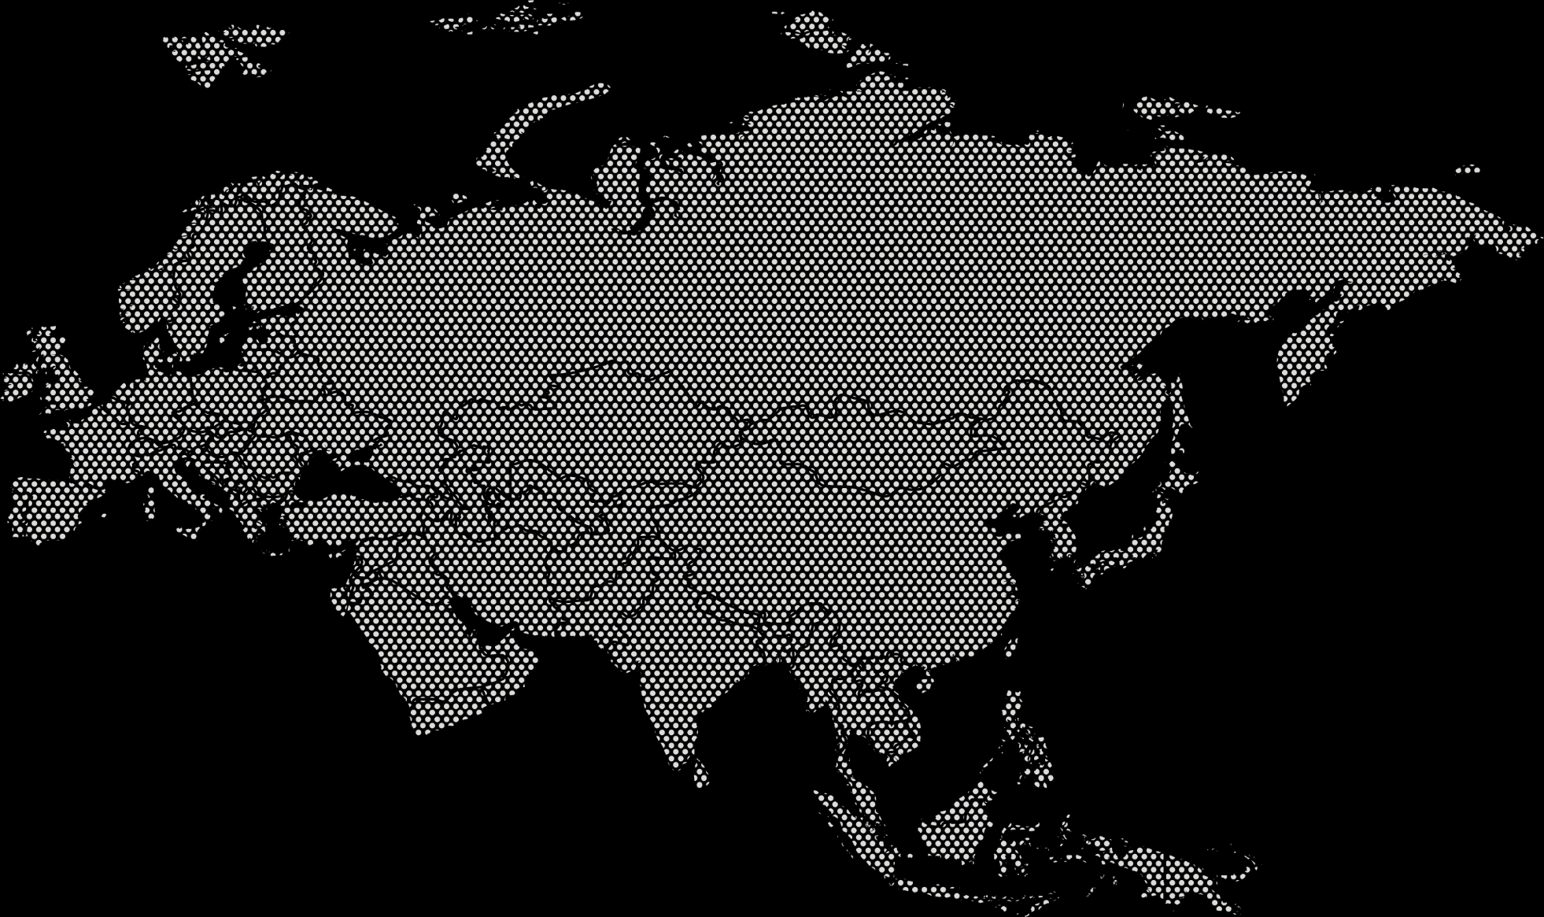
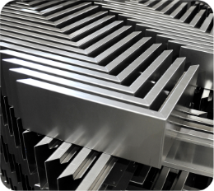
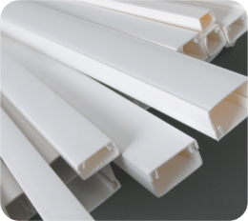
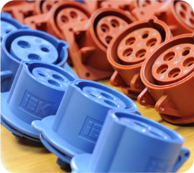
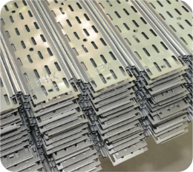
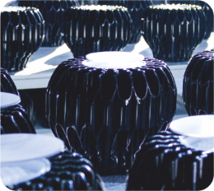
Made in Russia
Metalwork
Extrusion
Cast production
Rolled metal products
Lighting
Riga
Moscow
Kazan
Yasnogorsk
Novosibirsk
Chisinau
IEK GROUP
manufacturing facilities
Almaty
Ulaanbaatar
Vladivostok
Tbilisi
Tashkent
IEK GROUP warehouses
Ningbo
Software development
Ho Chi Minh

Slide 15
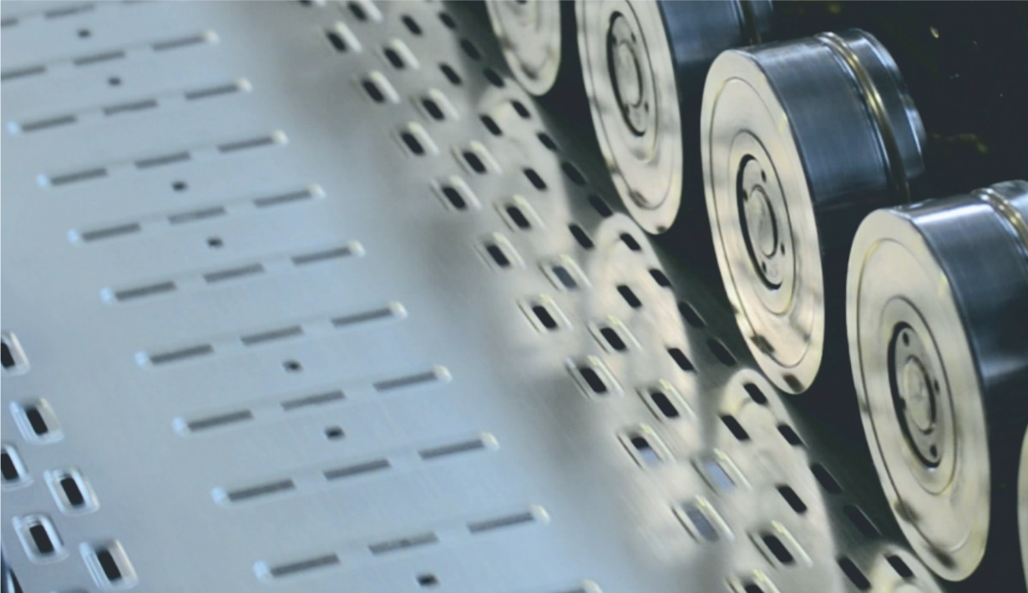
100% owned production in Russia
Annually production volume
Large-scale
modernization
2,2 Million
of metal boxes
5,9 Million
plastic boxes
Growth
of facilities
26 Million
meters of metal cable trays
273 Million
meters of plastic cable carrying systems
Automated
lines
1,34 Million
of luminaries
>13 million USD
Annual investments in the development of production facilities

Slide 16
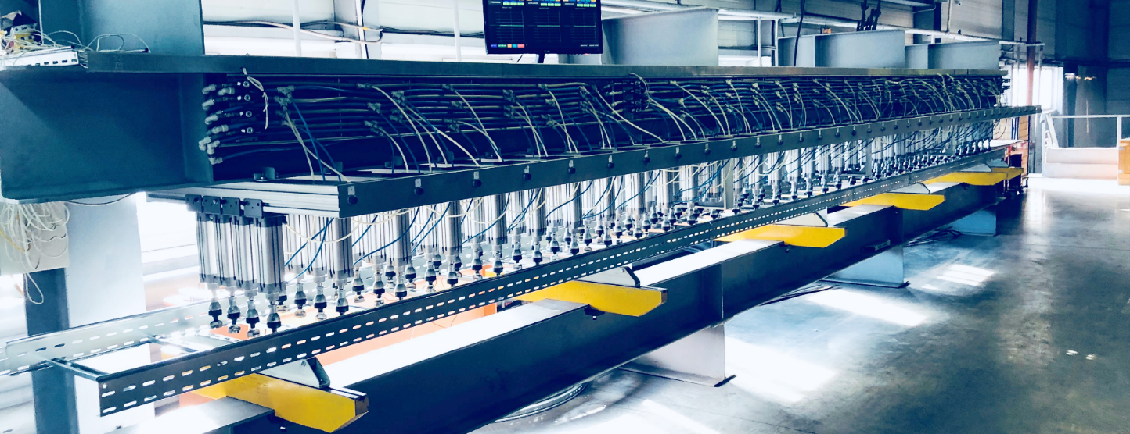
R&D
Own design engineering bureau, equipped laboratories
Patents and Certificates

Slide 17
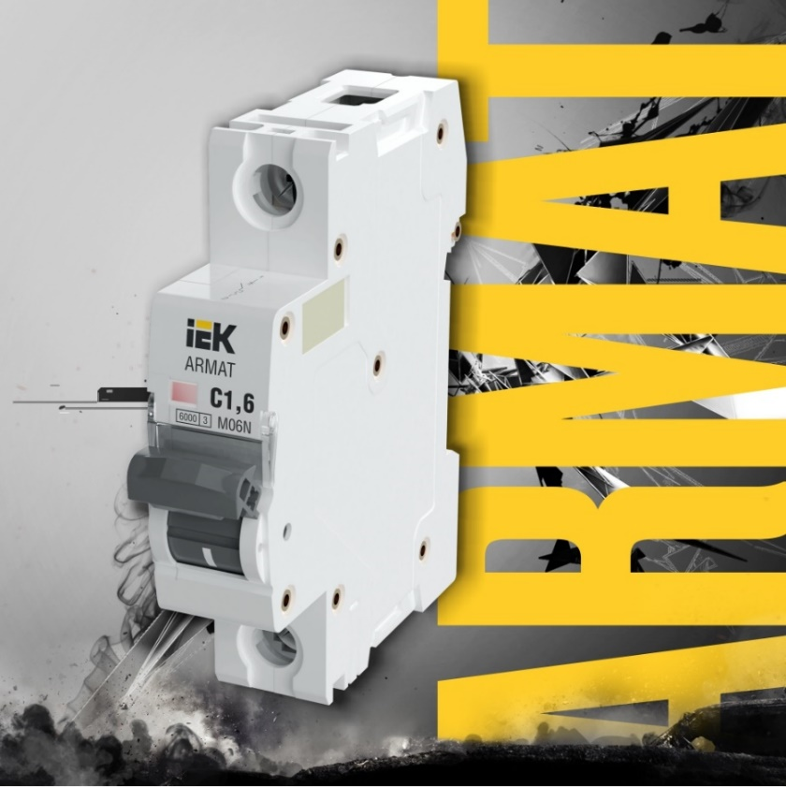
Key Projects
ARMAT
IEK® Modular equipment
High tripping speed
Increased switching and electrical durability
Increased case thickness
Enhanced arc splitter
Universal for AC and DC solutions
Confirm to IEC 60947-2 and IEC 60898-1

Slide 18
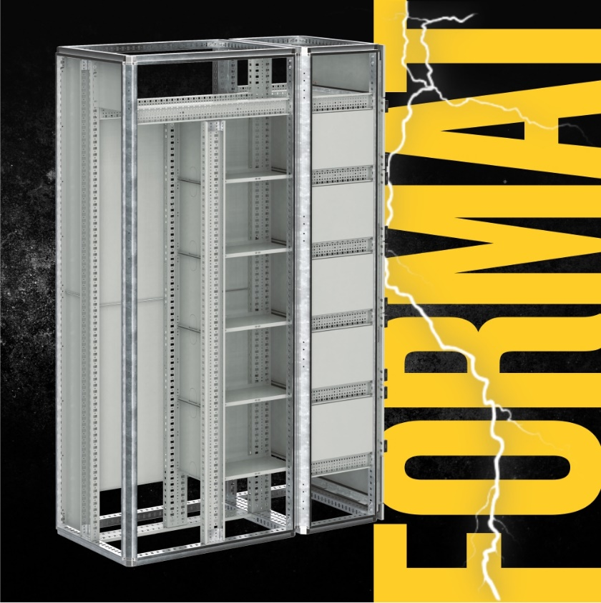
Key Projects
FORMAT
IEK® electrical cabinets up to 6300 A
Dismountable construction on a fully symmetrical profile
Up to 4b separation class
European certificates

Slide 19
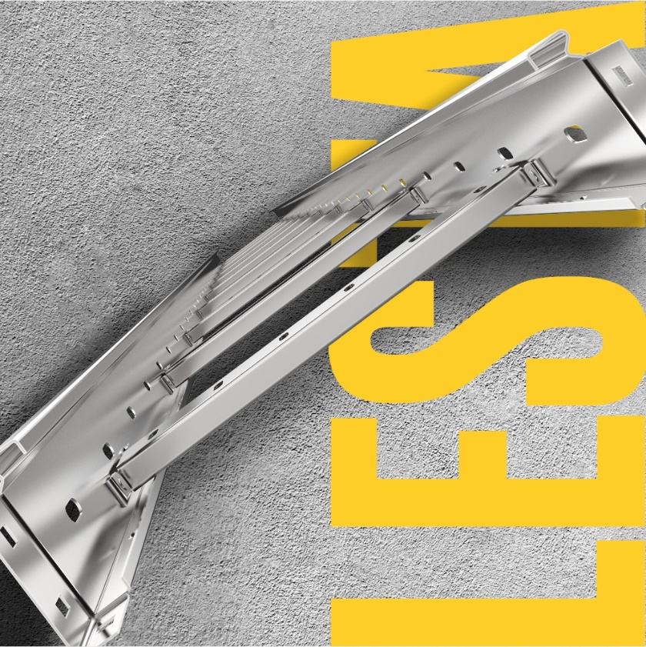
Key Projects
LESTA
IEK® Metal ladder trays
Unique design – increased hardness, increased bearing capacity
Optimal set of accessories
Reinforced telescopic connection
Bonding technology – clinching

Slide 20
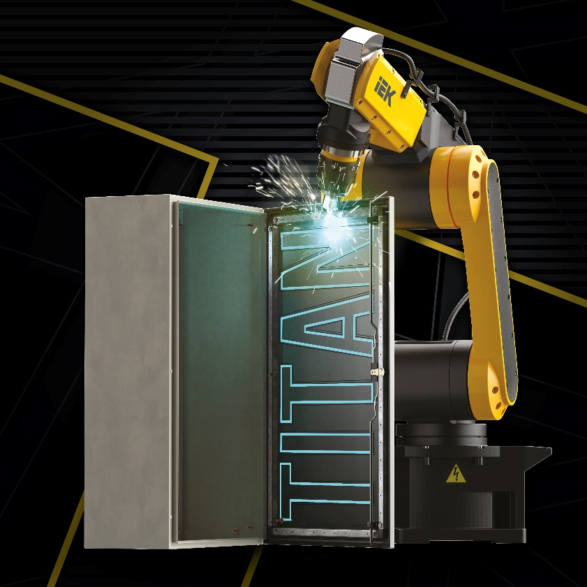
Key Projects
TITAN 5
IEK® Metal cabinets
New construction with removable mounting frame – convenience and ease of assembly
A set of necessary accessories – busbars and non-flammable support included
Wide range of sizes – up to 216 modules

Slide 21
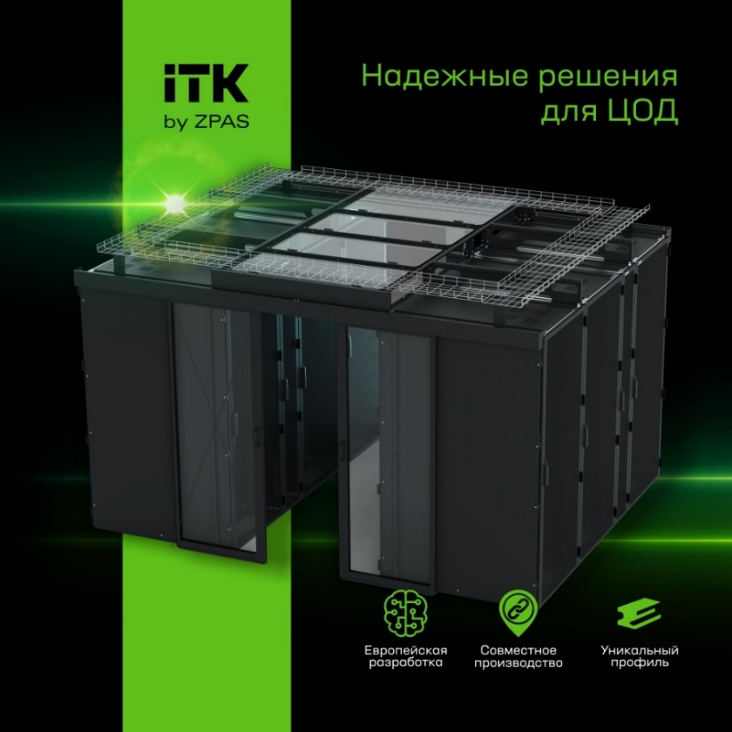
Key Projects
ITK® by ZPAS
Complex solutions for data centers
Server cabinets ITK® by ZPAS
Accessories
Optic wire tray system
Air conditioning systems for data centers
Monitoring systems

Slide 22
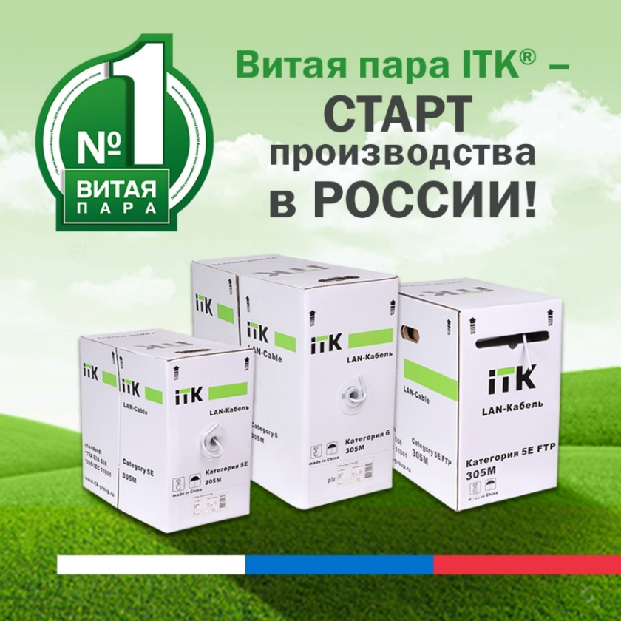
Key Projects
Twisted copper pair wire ITK®
Made in Russia
Fire-resistant cable for fire protection systems. European development
Industrial RS-485 cable smart energy meters
Fire-resistant RS-485 cable, halogen-free for industrial enterprises, armored

Slide 23
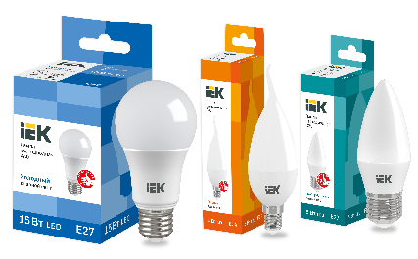
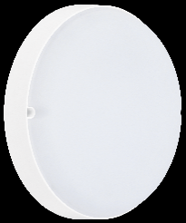
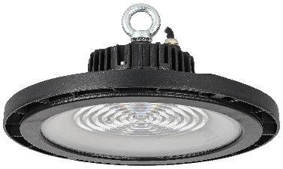
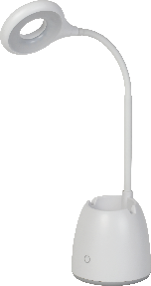
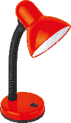
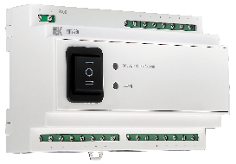
Key Projects
LED lamps IEK® Wide product range Color rendering index: Ra>80 No pulsation | Commercial lighting High light output: 110 lm/W Made in Russia Warranty: 5 years
Residential lighting High light output: 95 lm/W Degree of protection: IP54 Warranty: 2 years | Industrial lighting High light output: 110 lm/W Life time: 100 000 h. Warranty: 5 years
Luminaries for the home Wide range of additional features No pulsation | Emergency lighting. Remote testing and control of emergency luminaires Warranty: 5 years

Slide 24
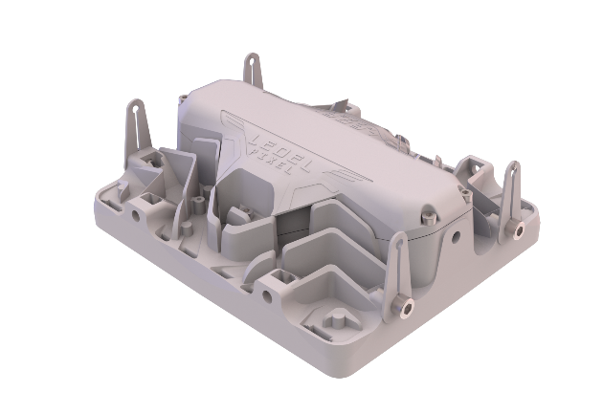
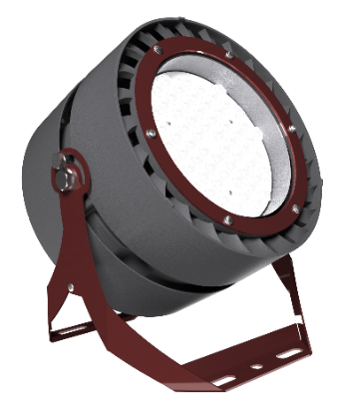
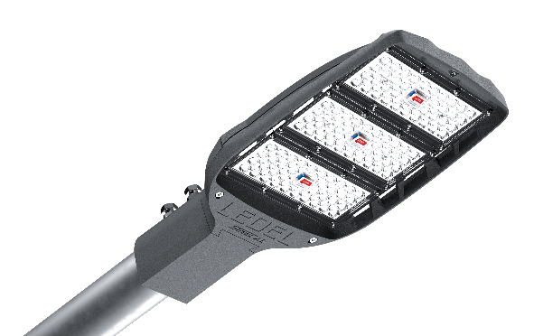
Key Projects
L-industry II banner
Multilens floodlight
Increased reliability due to
enhanced natural convection
L-pixel
Top industry luminaire
Extremely protected and compact case
Street X1
Top street and road luminaire
Light output up to 180 lm/W
Power from 27 up to 250 W
Control systems

Slide 25
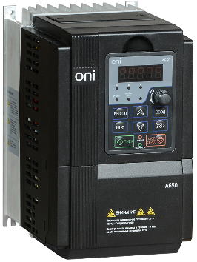
Key Projects
Complex solutions for engineering systems
Vertically integrated control system development platform
Automatic load transfer
Sewage pumping station automation system

Slide 26
Quality standards
Client-oriented focus
Customers and partners’ satisfaction
Stability in quality of products
Obligatory and voluntary certification
Business System
Quality management
Quality mark
Constant perfection and development
Compliance with ISO 9001-2015 requirements

Slide 27
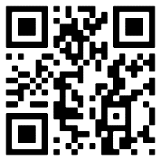
IEK GROUP Academy
Courses and tests
Sales Training
Webinars
Education videos
Seminars, Trainings and master-classes
Annually on an open educational and digital platform for market professionals
80,000 e-courses studied
13,000 webinar participants
4,000 participants in face-to-face training
academy.iek.group

Slide 28
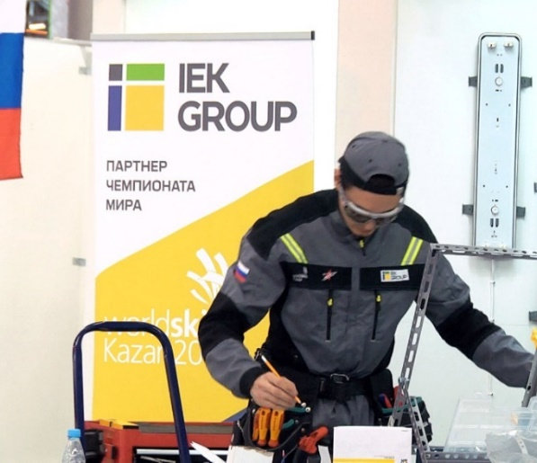
Participation in development of the field’s expertise
Field expert of the Worldskills international Electrical Installation standard
Worldskills Russia partner since 2013
Cofounder of «Electric Installation» competence in Russia
Participant of national carrier-guidance programs
Professional development programs for youth

Slide 29
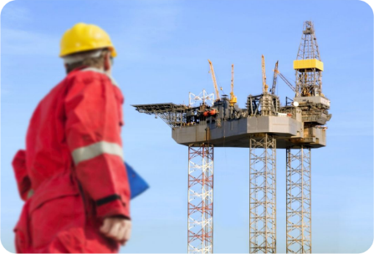
Solutions for various industries
for residential buildings
for residential buildings
for telecommunications
for oil and gas industry
for road construction
for agricultural sector

Slide 30
Our partners

Slide 31
Our partners
Headquarters of IEK GROUP, RUSSIA
Address:108803 Moscow Varshavskoye Shosse 28-th km. building 3
Tel./fax: +7 495 542 22 22
Email: sales@iekgroup.com
Meanwhile the wide range of representative offices include:
BELARUS
Address: REPUBLIC of BELARUS, 220025, Minsk, Shafarnyanskaya str., 11 apt. 62, office 204;
Phone: +375(17) 268-36-29; +375(44) 555-8-550
Email: iek.by@iek.ru
MOLDOVA
Address: 21 Maria Dragan str., Chisinau, MD-2044, the Republic of Moldova
Telephone: +373 (22) 479-065, +373 (22) 479-066
Fax: +373 (22) 479-067
E-mail: info@iek.md; infomd@md.iek.ru
Web-site: www.iek.md
LATVIA
SIA "IEK Northern Europe"
Address: Maskavas iela 497, Rumbula, Stopiņu pagasts, Ropažu novads, LV-2121, Latvija
Tel: +371 67205159, +371 28684723
Е-mail: infoneu@iek.group
Web: www.iek.group
KAZAKHSTAN
Address: KAZAKHSTAN, 040916 Almaty Region, Karasay District, Irgely village, Akzhol Micro-District 71А
Telephone: +7-727-237-92-50
E-mail: infokz@iek.ru
Web-site: www.iek.kz
MONGOLIA
Address: MONGOLIA, Ulan Bator, Plot 20 of Bayangol District, Western Zone of Industrial Area 16100, Moscow Street, 9
Telephone: +976 7015-28-28
Fax: +976 7016-28-28
E-mail: info@iek.mn
Web-site: www.iek.mn
UZBEKISTAN
Address: REPUBLIC of Uzbekistan, 100074, Tashkent, Yashnabadsky district, Mukhtara Ashrafii str., 1-st drive. 9a bld.
Phone: +998 (71) 231-84-31, +998 (71) 231-84-32
Email: info@iek.uz
VIETNAM
IEK South East Asia
Address: room 23, 2nd Floor, Hado Airport Building, No. 2 Hong Ha Street, Ward 2 , Tan Binh District, Ho Chi Minh City, Vietnam
Email: infosea@iek.group
Web-site: www.iekglobal.vn

